Slide 1
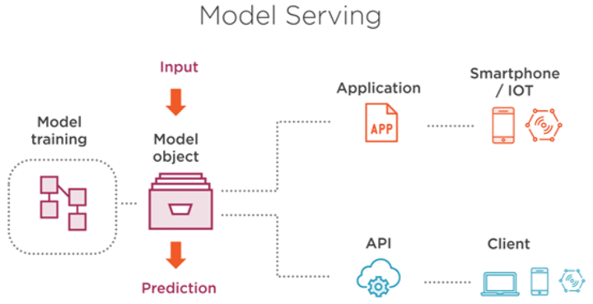




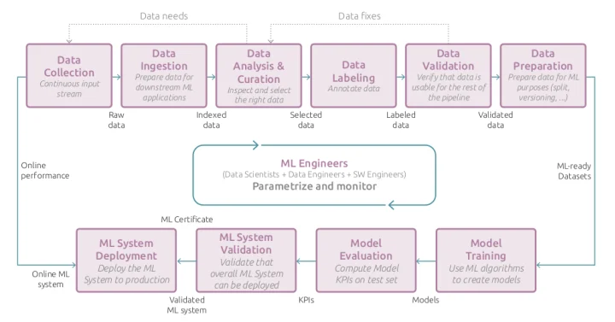




What is REST API

Slide 2
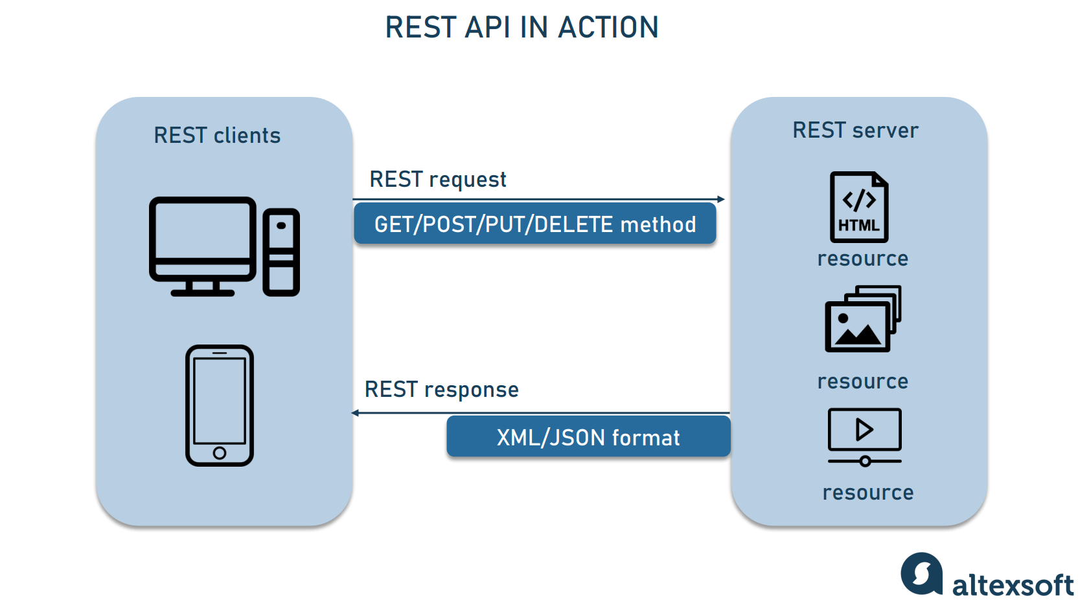
API Request Types
https://developer.mozilla.org/en-US/docs/Web/HTTP/Methods

Slide 3
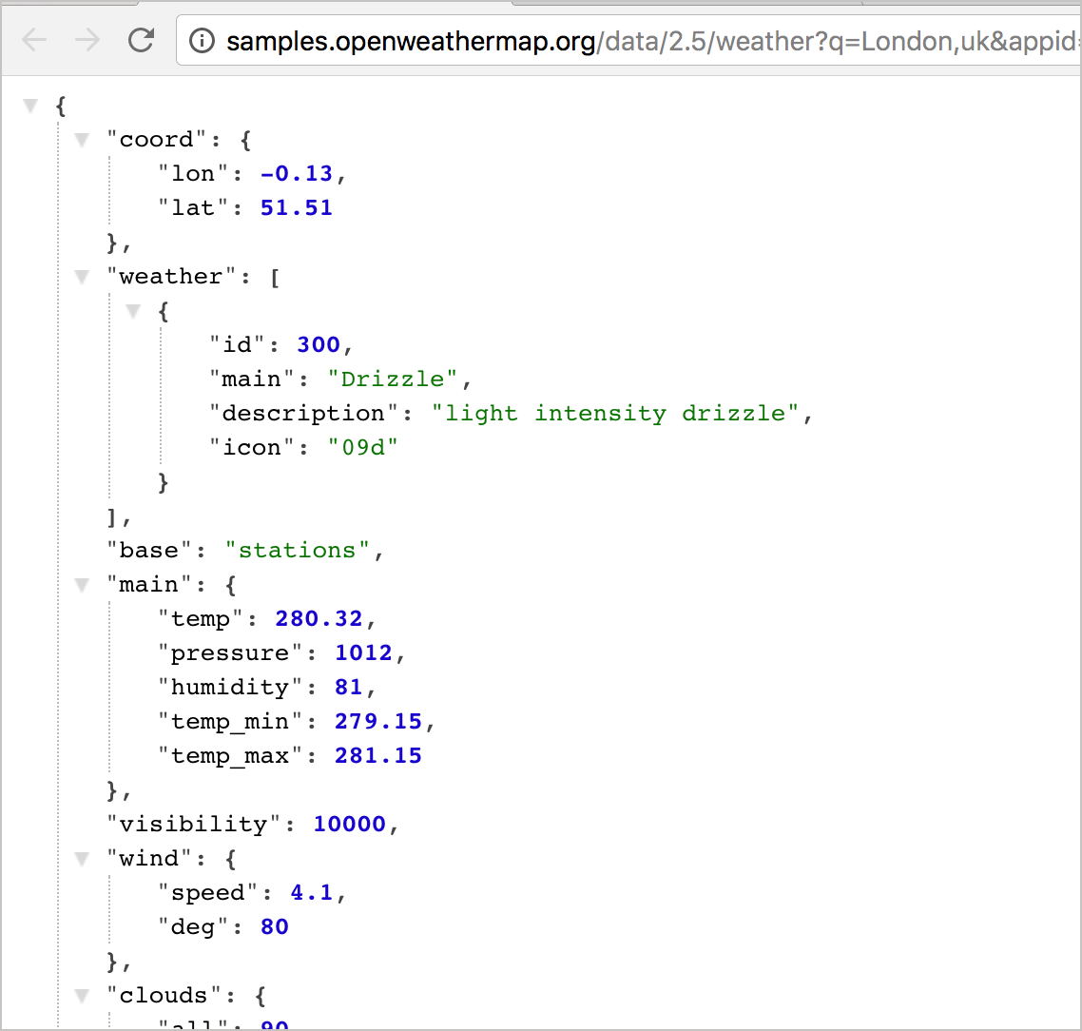
API Response Types
https://openweathermap.org/api/one-call-api
https://developer.mozilla.org/en-US/docs/Web/HTTP/Status

Slide 4
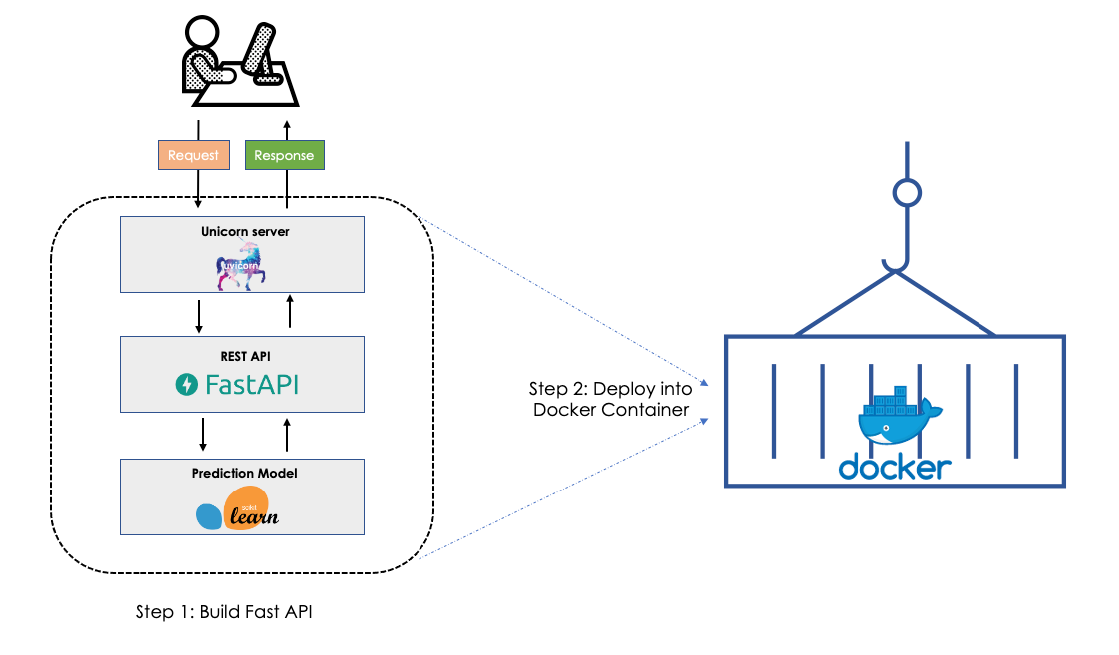
What is FastAPI

